Slide 1
Final Project: London Segmentation

Slide 2
Introduction
London has one of the most sought-after real-estate markets. It’s cosmopolitan and vibrant lifestyle makes it also when the of the world’s top destination for tourists.
The aim of this project was to segment London using the most common venues in each area and compare it with the average home prices in the same area to understand if there is a relationship between the type and frequency of venues and home prices.
The analysis would potentially help real-estate investors understand if the relationship between some venues will lead to an increase in the prices of properties and therefore return on their investments.

Slide 3
Data Used
Three datasets are used:
Venues and places data from Foursquare to identify the top common places in each area
London's average home prices per area from London DataStore, which will be combined with the common places to identify an interesting insight.
London's areas coordinate from London DataStore, which will be used to get the common places in from Foursquare

Slide 4
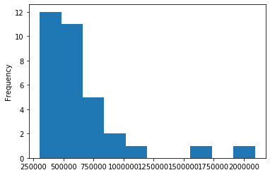
Methodology
Explored the areas covered in the datasets to ensure consistency in both datasets, specifically with regards to the names of areas.
Applied a simple histogram plot to explore the distribution of the prices of the data. As shown in the plot below, home prices are skewed towards 250,000 to 750,000 range, with fewer areas in the 1,000,000 + range

Slide 5
Applied some descriptive analysis to show the distribution of the data as shown below:
count 3.300000e+01
mean 6.654116e+05
std 3.725934e+05
min 3.015180e+05
25% 4.599220e+05
50% 5.739380e+05
75% 6.839870e+05
max 2.092485e+06

Slide 6
Based on the previous two steps, the areas were categorised according to the average prices in each area. The purpose of this step was to see if insights can be identified on a category level (See below table).
Price Cat 1: Areas above the 95% percentile
Price Cat 2: Areas between 75% and 95% percentile
Price Cat 3: Areas between 50% and 75% percentile
Price Cat 4: Areas between 25% and 50% percentile
Price Cat 5: Areas between 0% and 25% percentile

Slide 7
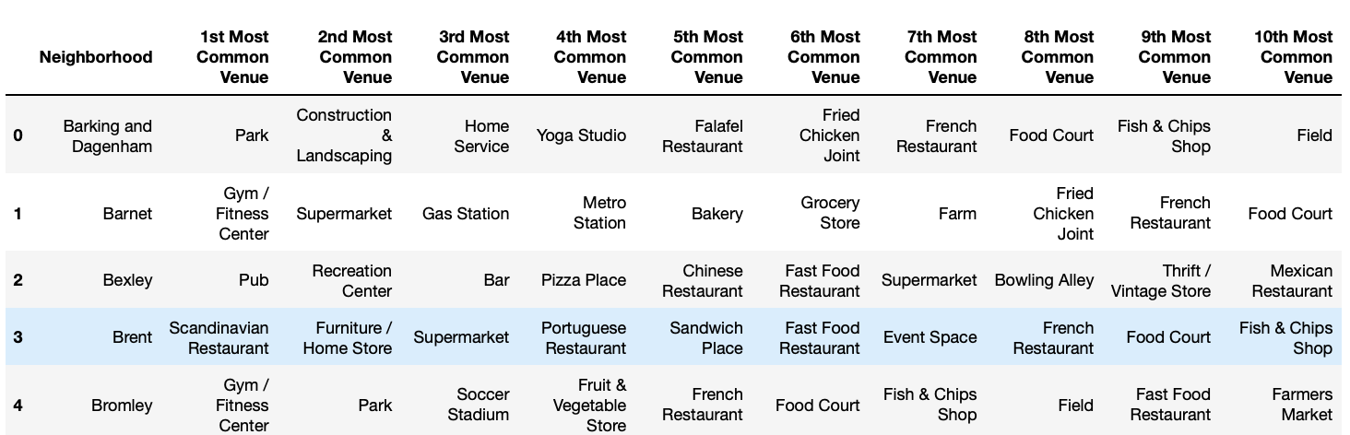
Data was fetched from Foursquare for the top venues in each area and plotted on a bar chart to better understand the distribution and which areas had the most venues

Slide 8
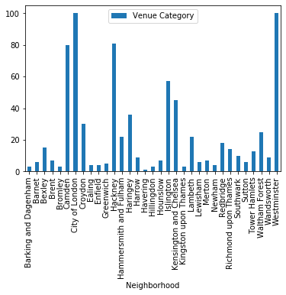
As seen in the chart below, Westminster and City of London are the only two areas that have delivered the maximum, 100 venues.

Slide 9
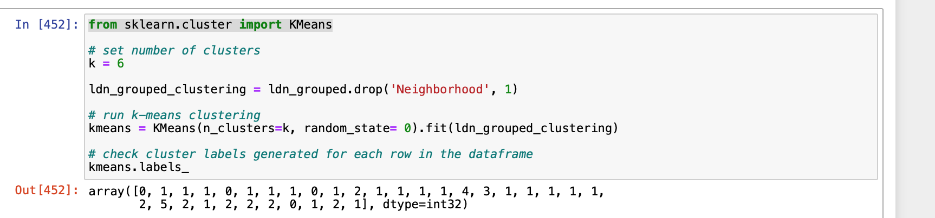
Finally, K-means was applied to data after one-hot encoding int. Multiple values for K were tested with little impact to the results, until settling on 6.

Slide 10
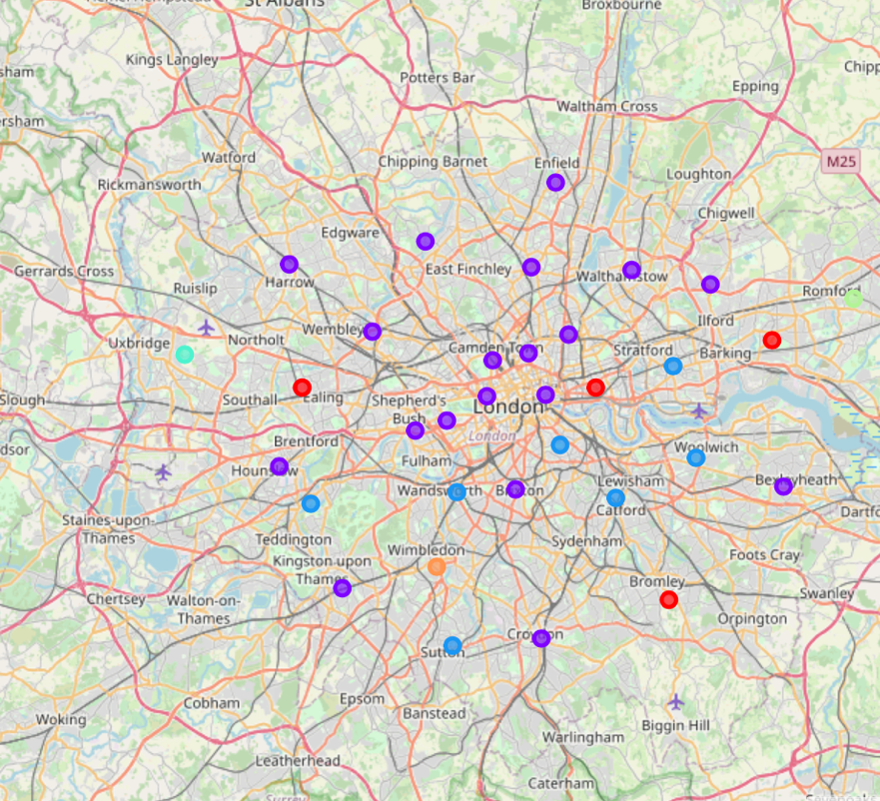
Results: K-means model delivered the following labels to the 33 areas based on their top 10 venues
array([0, 1, 1, 1, 0, 1, 1, 1, 0, 1, 2, 1, 1, 1, 1, 4, 3, 1, 1, 1, 1, 1, 2, 5, 2, 1, 2, 2, 2, 0, 1, 2, 1], dtype=int32)
The clusters were then visualised in on the map below for further inspection.

Slide 11
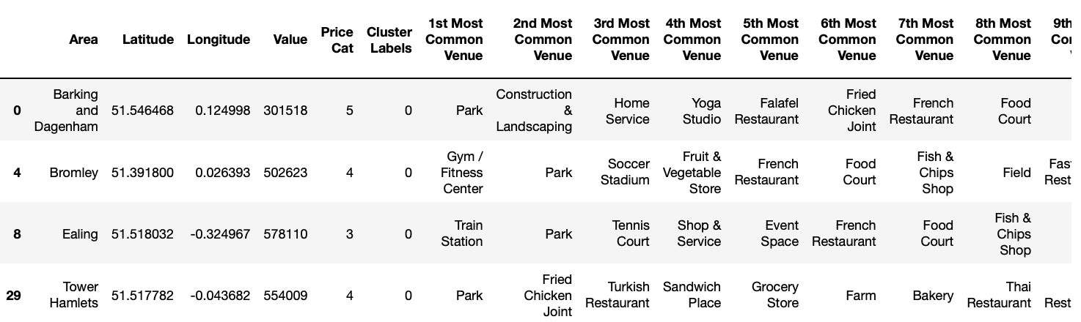
Figure below shows Cluster 0, which I can only assume that it was clustered on the basis of having Park as the number 1 or 2 common place.

Slide 12
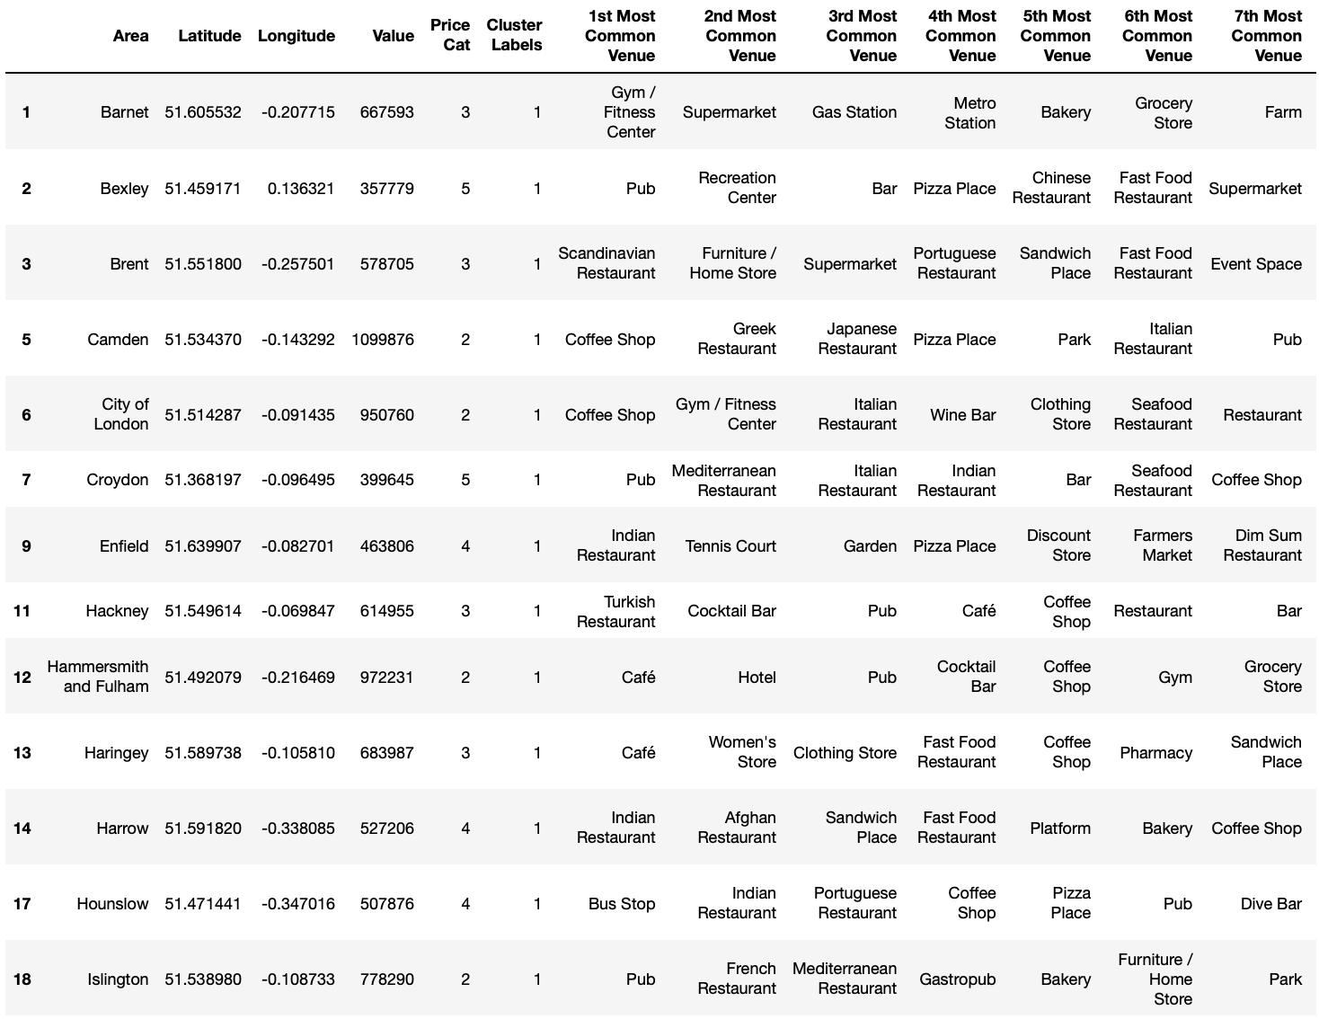
The model clustered most of the areas as Cluster 1 as shown below. It’s unclear from the results the basis on which the model did this segmentation. Perhaps it was the number of coffee shops, or just poor application of the model/ an unapparent insight.

Slide 13
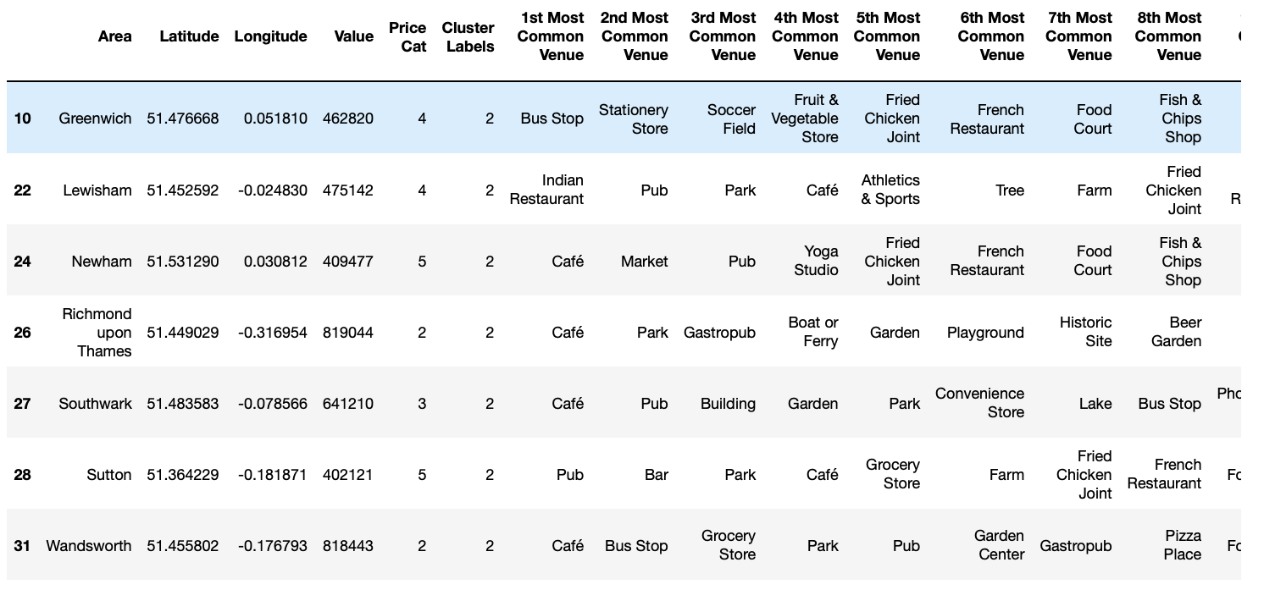
The figure below shows the results for cluster 2. The majority of the areas in this cluster have Café as their most common venue.

Slide 14
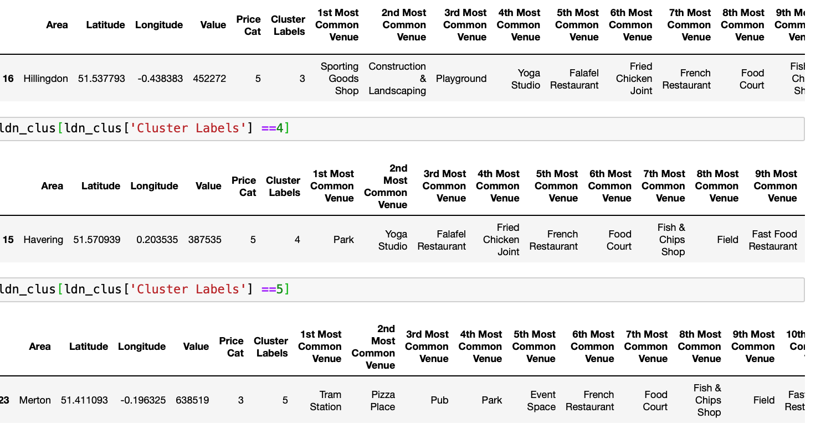
Clusters 3, 4, and 5 shows below do not show any distinctive information to why the model had clustered them in this manner.

Slide 15
Conclusion
The approach to modelling the problem was not suitable. A different approach is recommended as next steps. Perhaps one that looks into correlating the number of venues within each category with the increase in prices. Perhaps a combination of time series analysis that reflects price increase with changes in frequency of types of venues.

